Slide 1
Coursera
Car Accident Severity Presentation
Captone Project
Mighty Hlungwane

Slide 2
Introduction
We will be using Machine Learning algorithms to predict the severity of car accidents in Seattle from 2004 to 2020 with certain conditions concerning the environment – Speeding, Driving Under Influence (DUI), In-attention, Hitting a parked car, etc.
The Objective of this Presentation:
To assess the risk of accidents and provide advise on how to avoid such accidents in the future.

Slide 3
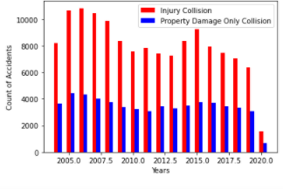
Number of Accidents and The results of the Collision From 2004-2020
a) The Number of accidents in both the Severity classes have been decreasing over the years.
b) The drastic drop in 2020 is due to there being data for part of the year.

Slide 4
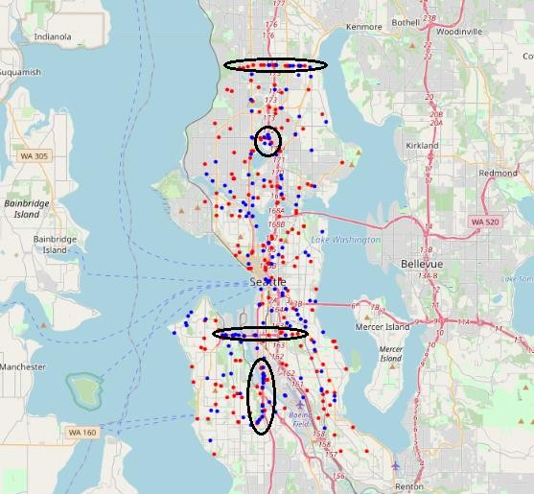
Circle indicate Areas Where Accidents Caused by Speeding
1. Severity value of 1 shown by RED circle
2. Severity value of 2 shown by BLUE circle
3. Data plotted is for years 2017 – 2020 for all graphs except for feature: Hitting Parked Car

Slide 5
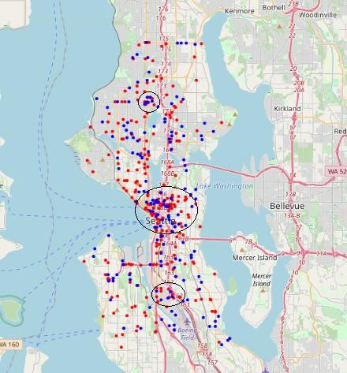
Circle indicate Areas Where Accidents Caused by Driving Under Influence
1. Severity value of 1 shown by RED circle.
2. Severity value of 2 shown by BLUE circle.
3. Data plotted is for years 2017 – 2020 for all graphs except for feature: Hitting Parked Car.

Slide 6
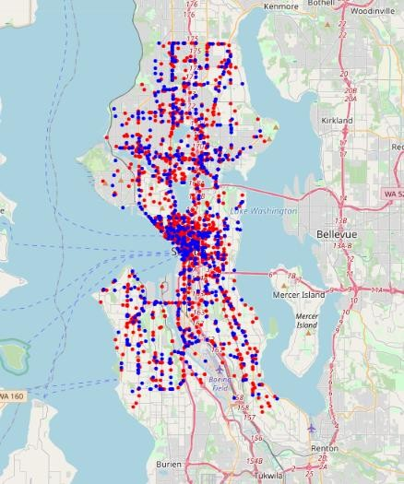
Accidents Caused by In-Attention
1. Severity value of 1 shown by RED circle.
2. Severity value of 2 shown by BLUE circle.
3. Data plotted is for years 2017 – 2020 for all graphs except for feature: Hitting Parked Car.

Slide 7
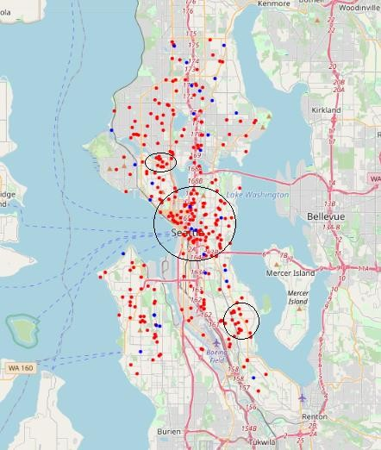
Circle indicate Areas Where Accidents Caused by Hitting Parked Cars
1. Severity value of 1 shown by RED circle
2. Severity value of 2 shown by BLUE circle
3. Data plotted is for years 2017 – 2020 for all graphs except for feature: Hitting Parked Car.

Slide 8
Conclusion
The exploratory data analysis shows density of accidents based on geography based on Speeding, Driving-Under-Influence, In-attention and Hitting Parked Cars.
The data-set has helped us classify the severity of the accidents based on certain selected features on how accidents occurred in the past.
This is going to help us anticipate what to expect, and hence prevent any further accidents from happening. Although it's impossible to prevent car accidents from happening entirely; it still helps to locate the hot-spots for most accidents and start taking precautions from there in accordance with our visual aid we have created in this project.

Slide 9
Questions?

